Slide 1
WorkshopPLUS Power Platform for Administrators
Power Platform Environments
Notes:
Workshop Version: 2.6

Slide 2
Conditions and terms of use
© Microsoft Corporation. All rights reserved.
You may use these training materials solely for your personal internal reference and non-commercial purposes. You may not distribute, transmit, resell or otherwise make these training materials available to any other person or party without express permission from Microsoft Corporation. URL’s or other internet website references in the training materials may change without notice. Unless otherwise noted, any companies, organizations, domain names, e-mail addresses, people, places and events depicted in the training materials are for illustration only and are fictitious. No real association is intended or inferred. THESE TRAINING MATERIALS ARE PROVIDED “AS IS”; MICROSOFT MAKES NO WARRANTIES, EXPRESS OR IMPLIED IN THESE TRAINING MATERIALS

Slide 3

Objectives
After completing this Learning, you will be able to:
 | 1 | Understand…. What Power Platform environments are Environments storage capacity requirements and limits
 | 2 | Understand…. What security roles are available for Power Platform administration Basics about Dataverse security model and most important security roles
 | 3 | Understand…. Managing Environments How environment backup/restore/recovery works
 | 4 | Understand…. Lifecycle of Dataverse for Teams environment

Slide 4
Understanding Environments

Slide 5
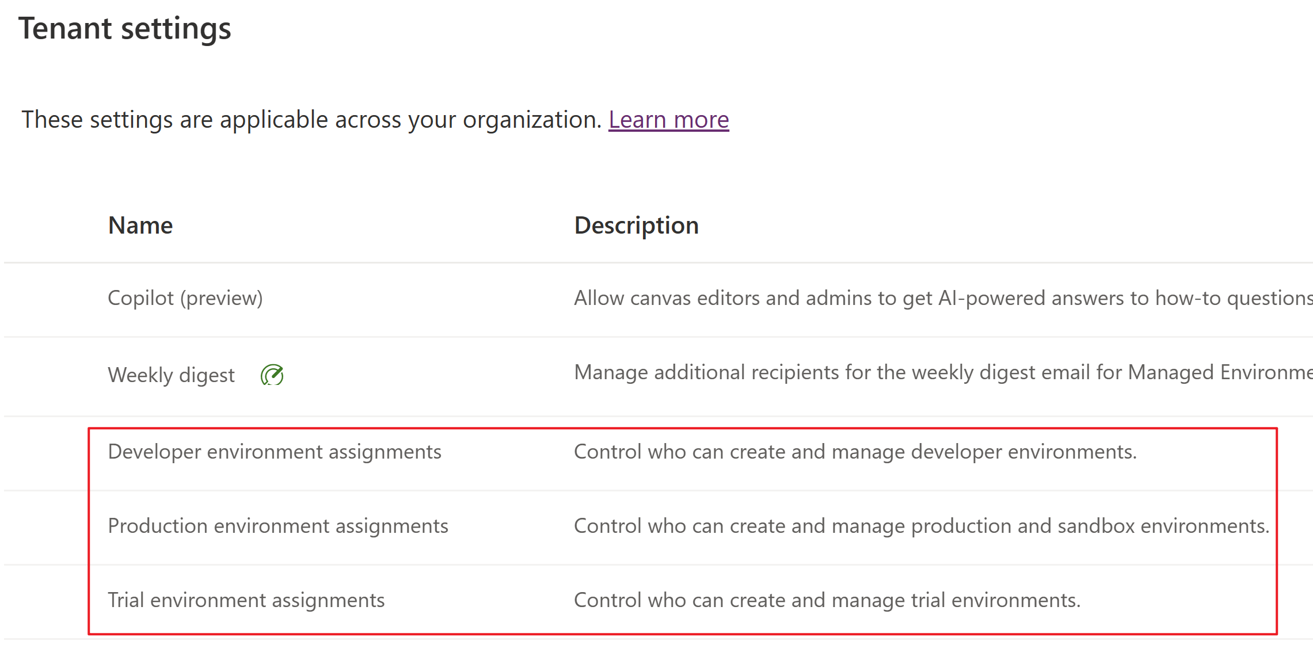
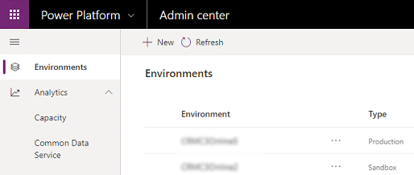
Power Platform Environment
Definition:
Container to store, manage, and share your organization's business data, apps, flows, chatbots, and other Power Platform resources
Serves as a container to separate apps that might have different roles, security requirements, or target audiences
Key facts:
Every tenant has a Default environment where all licensed Power Apps and Power Automate users can create apps & flows.
Tied to a geographic location
Different types of environment exist
Can have either zero or one Dataverse database
Security tips:
Non-default environments offer more permission controls.
Non-default environment creation can be restricted to specific admins.
Non-default and non-developer environments with Dataverse can restrict access to a specific AAD security group.
Controlling environment creation in the admin center.
List of environments in the admin center.
Microsoft Confidential

Slide 6
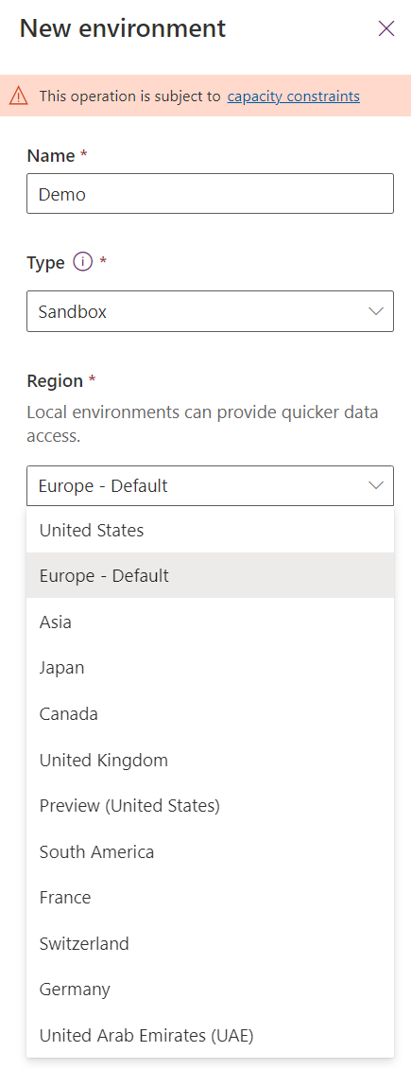
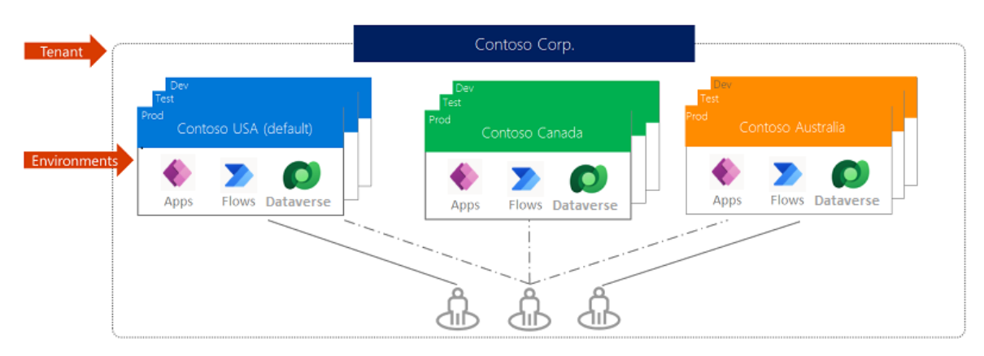
Environment Scope
Environments are created under an Azure Active Directory tenant, and its resources can only be accessed by users within that tenant.
Any resources created in an environment like apps, flows, connections, Dataverse database etc. are bound to datacenters in the geographic location selected for an environment
An app, for example, created in the environment is only permitted to connect to the data sources that are also deployed in that same environment, including connections, gateways, flows, and Dataverse databases.
Microsoft Confidential

Slide 7
Environment Types
More details in upcoming slides
Type | Creator | Description
Default | Auto-created | A single default environment is automatically created for each tenant and shared by all users (who are Environment Makers).
Production | Licensed user, subject to tenant level setting | Intended to be used for permanent work in an organization. Production environments are what you should use for any environments on which you depend.
Sandbox | Licensed user, subject to tenant level setting | Sandbox environments are used for development and testing, separate from production.
Trial | Licensed user, subject to tenant level setting | Trial environments are intended to support short-term testing needs and are automatically cleaned up after a short period of time.
Developer | Licensed user | Developer environments are created by users who have a free Power Platform Developer Plan license. These are special environments intended only for use by the owner but other makers can be added for app/flow development. Premium connectors can be used.
Dataverse for Teams | Auto-created | Dataverse for Teams environments are automatically created for a Team in Teams when you create an app in Teams using the Power Apps app for the first time or install a Power Apps app from the app catalog.
Support | Microsoft support engineer | It is an environment created in your tenant by Microsoft under your direct instructions, for purposes of preventing, detecting, or repairing problems affecting the operation of your online service.

Slide 8
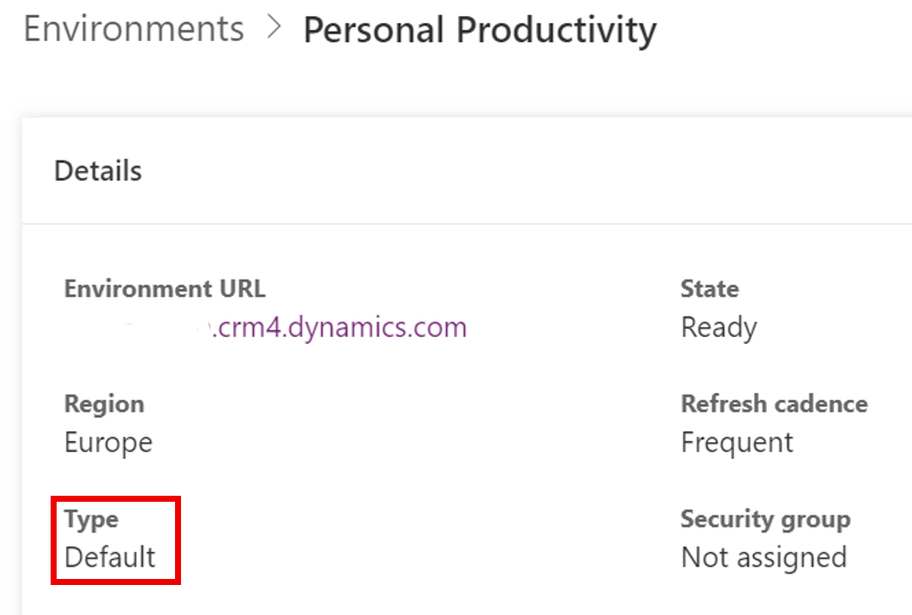
Default environment
Definition:
A single default environment is automatically created for each tenant and is shared by all users in the tenant (who are Environment Makers). Learn more here.
Key facts:
Whenever a new user creates their first Power App or Power Automate flow, they're automatically added to the Environment Maker role.
Default is not for development of critical apps.
Can't be disabled or deleted
You can't back up manually. System backups are done continuously.
Limited to 1TB of storage capacity
Security tips:
Rename the environment to make the purpose of that environment self-explanatory like “Personal Productivity”
Configure a strict Data Loss Prevention (DLP) policy to control the connectors that can be used by apps and flows in the default environment.
More info - Manage the default environment - Power Platform | Microsoft Learn
Microsoft Confidential

Slide 9
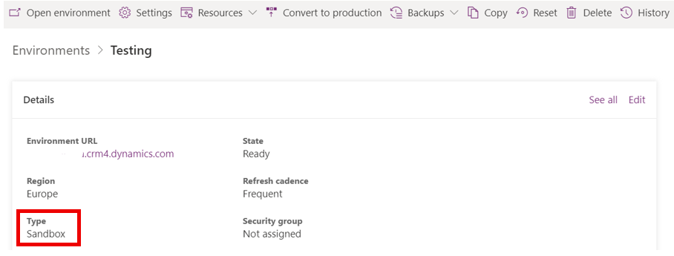
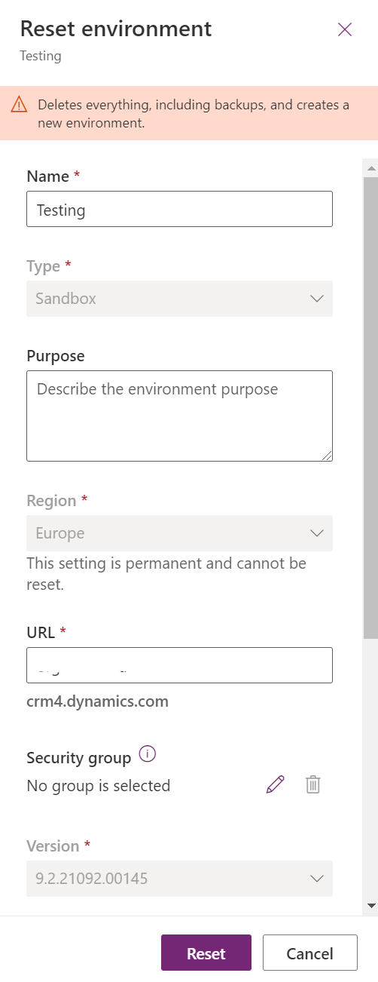
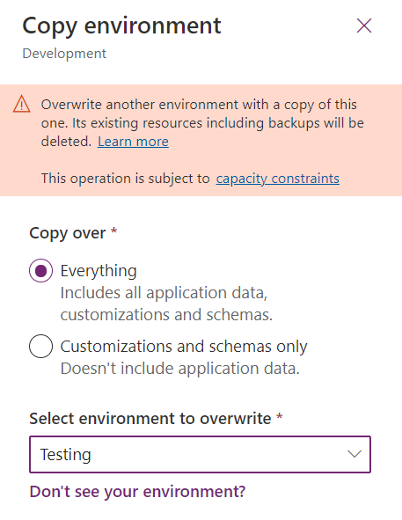
Sandbox environment
Definition:
Non-production environments.
Isolated from production, a sandbox environment is the place to safely develop and test application changes with low risk. Learn more here.
Key facts:
Can be converted to Production environment
Possible to create own backups along system backups and restore backups 7 days back in time (28 days if any Dynamics 365 app is deployed to environment)
Copy Dynamics 365 customer engagement apps (Sales, Customer Service, Field Service, Marketing, and Project Service Automation), and all data between environments
Reset to delete and reprovision it
If environment has AAD Security Group defined, then you need to set a new group during the reset.
Consider a reset when you want to: Create a new project, free up storage or remove personal data.
Microsoft Confidential

Slide 10
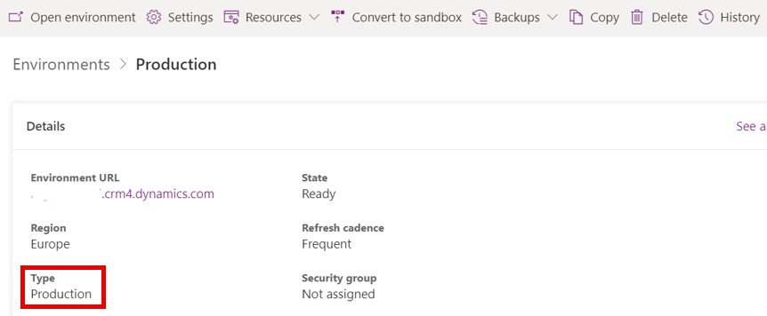
Production environment
Definition:
Environment for resources like apps, flows, chatbots etc. which are meant to be released to a target audience e.g., end users of a Power App
Key facts:
Can be converted to Sandbox environment
Possible to create own backups along system backups and restore backups 7 days back in time (28 days if any Dynamics 365 app is deployed to environment)
Copy Dynamics 365 customer engagement apps (Sales, Customer Service, Field Service, Marketing, and Project Service Automation), and all data between environments
Microsoft Confidential

Slide 11
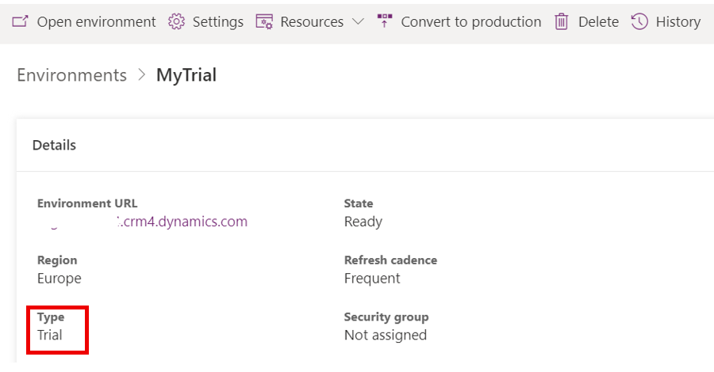
Trial environment
Definition:
Using trial environments, companies can try out new features and solutions. Learn more here.
Two types of trial environments:
Trial (standard) - Allow users to try new features and quickly build low-code and no-code POC applications and processes.
Trial (subscription-based) - Companies can use to develop larger, multiuser, and multiple-department solutions and perform proof-of-concept reviews. Tenant admins can add a trial (subscription-based) environment to their tenant.
Key facts:
Users with eligible license like Power Apps per User can create one trial environment at a time
Does not consume paid capacity of the tenant
Can be converted to Production environment
Will be automatically deleted after 30 days but can be extended for additional 30 days and 7 days before environment is set to expire
Only one extension is allowed per trial environment.
Microsoft Confidential

Slide 12
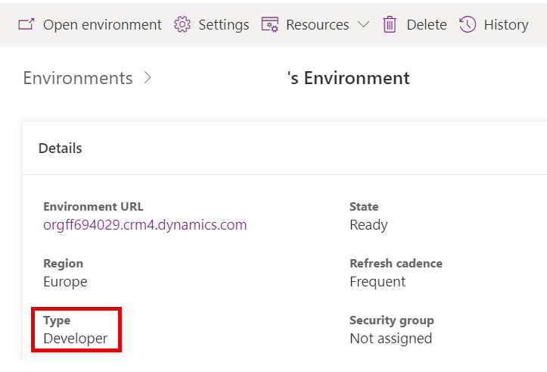
Developer environment (Developer Plan)
Definition:
You get a free developer environment to develop and test apps, including support for premium and custom connectors and Dataverse. Learn more here.
Key facts:
Create apps and flow and share and collaborate on these solutions with others.
Connect to any data source by using OOB connectors or by creating custom connectors.
Use a fully managed, scalable data platform with Dataverse
Export the solutions you create in your developer environment and publish them on Microsoft AppSource, so your customers can test-drive them.
Not meant for production use
Environment capacity limits are:
Flow runs/month – 750
Database size – 2GB
A free Microsoft Power Apps for Developer Plan license is assigned to the user
Microsoft Confidential
Notes:
Preview – Makers will be able to create up to 3 Developer environments - https://learn.microsoft.com/en-us/power-apps/maker/maker-create-environment
Create your own environment when you sign up for the Power Apps Developer Plan
The Power Apps Developer Plan gives you up to three free development type environments to build and test with Power Apps, Power Automate, and Microsoft Dataverse. The developer environments maintained under this plan will be available as long as you actively use the Power Apps Developer Plan.

Slide 13
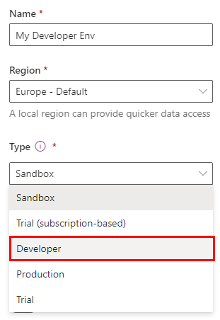
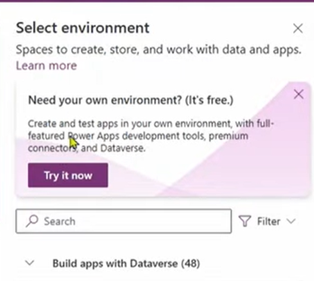
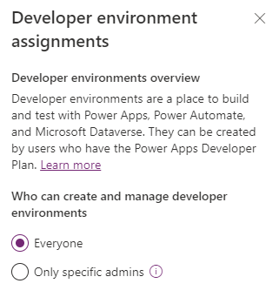
Developer environment (Personal)
Definition:
Developer environments (Personal) can be created without having Power Platform Developer plan
Key facts:
Same features and limits as Developer environments created by the system when user has Power Platform Developer plan
All users having seeded or standalone Power Platform license can create up to three Developer environments if not blocked in tenant level
Can be created in Power Platform Admin Center or Power Apps Studio (make.powerapps.com) in environment picker
Not meant for production use
Microsoft Confidential
Notes:
Preview – Makers will be able to create up to 3 Developer environments - https://learn.microsoft.com/en-us/power-apps/maker/maker-create-environment
Create your own environment when you sign up for the Power Apps Developer Plan
The Power Apps Developer Plan gives you up to three free development type environments to build and test with Power Apps, Power Automate, and Microsoft Dataverse. The developer environments maintained under this plan will be available as long as you actively use the Power Apps Developer Plan.

Slide 14
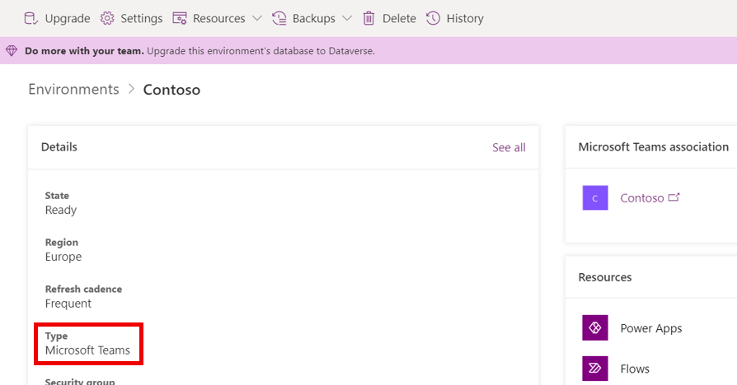
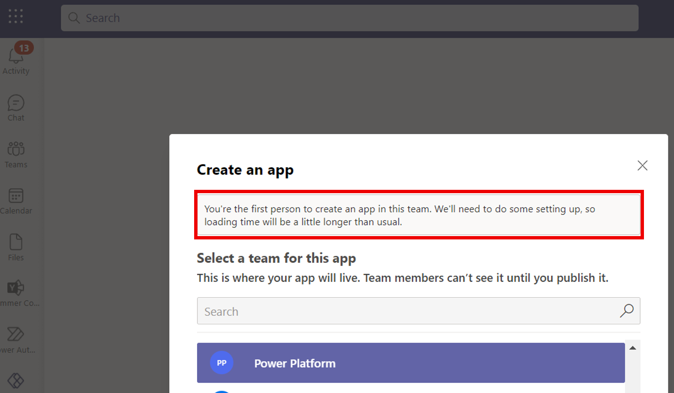
Dataverse for Teams environment
Definition:
Is automatically created for the selected team when you create an app or bot in Microsoft Teams or install a Power Apps app from the app catalog for the first time.
Each team can have one environment, and all data, apps, bots, and flows created with the Power Apps app inside a team are available from that team's Dataverse for Teams database.
Learn more here.
Key facts:
Available as part of select Microsoft 365 subscription like E3/E5
Possible to create own backups along system backups and restore backups 7 days back in time
Team guests can access apps, bots, flows, and data but not able to make or edit apps - only discover and run
Dataverse for Teams database (“light version” of Dataverse) can be upgraded to full version of Dataverse
Microsoft Confidential

Slide 15
Dataverse for Teams restrictions
Teams can invite guests who can discover & run apps, bots, flows, and access data in the Dataverse for Teams DB within their Team. However, they won't be allowed to install, make, or edit apps.
Dataverse for Teams Apps will only be accessible in Teams and Teams Mobile.
For any standalone Power Apps or Power Automate usage, which includes API access as well, the Dataverse for Teams schema will need to be promoted to Dataverse.
No direct API access or pro developer experience will be provided, and only Power Apps embedded within the Teams client will be able to access the runtime.
Apps created in Microsoft Teams that use Dataverse for Teams will be accessible outside of Microsoft Teams in a web browser if you have a trial or standalone Power Apps license. However, note the following:
Apps not displayed in make.powerapps.com or Power Apps mobile app
The only way to run these apps is to launch them in a web browser from Teams using Go to website or Open in browser in the Power Apps mobile app.
When run outside of Teams, the Teams integration object’s values won’t be available.
Microsoft Confidential

Slide 16
Create an environment
You can create environments in the Power Platform Admin Center (PPAC), PowerShell, or using Power Platform Management Connectors in Power Apps and Flows.
Environment can be created either with or without Dataverse database.
NOTE! These do not apply for Dataverse for Teams environments
To create an environment, all the following must be true:
The user has a license that allows environment creation.
Environment creation is allowed in tenant level for users (if not then allowed only for Global, Power Platform or Dynamics Admin).
For production and sandbox environments, the tenant must have at least 1GB of database storage capacity available.
For trial (standard) environments, the user needs a license providing per-user entitlement for trial environments (refer to the table above). This applies to tenant-level admins, as well.
For trial (subscription-based) environments, each offer-based trial (also known as "admin trial") subscription entitles the tenant to three subscription-based trial environments. Only tenant-level admins are able to provision trial (subscription-based) environments.
License | Trial | Production
Microsoft 365 Plans | No | No
Dynamics 365 Teams Plans | No | No
Power Platform Developer Plan | No | No
Dynamics 365 trial | Yes (one) | No
Dynamics 365 Plans | Yes (one) | Yes
Power Apps plan | Yes (one) | Yes
Power Apps trial | Yes (one) | Yes
Power Virtual Agents trial plan | Yes | No
Power Virtual Agents plan | No | Yes
NOTE! Global and Power Platform Administrators can create environments without any license
Microsoft Confidential

Slide 17

Demonstration
Create a trial environment with Dataverse database
Open PPAC
Verify that you have Power Apps per user license assigned for the user you are using (MOD Admin)
Also verify that you haven’t already created trial environment with that user as only 1 trial environment is allowed per user
In Environments page, click NEW
Set the following environment settings:
Name
Type = Trial
Show different regions and choose default region
Select “Create a database for this environment”
Click NEXT
You do not need to change anything in “Add database“ screen just go through different settings and options
Click SAVE to start environment creation
Notes:
Open PPAC
Verify that you have Power Apps per user license assigned for the user you are using (MOD Admin)
Also verify that you haven’t already created trial environment with that user as only 1 trial environment is allowed per user
In Environments page, click NEW
Set the following environment settings:
Name
Type = Trial
Show different regions and choose default region
Select “Create a database for this environment”
6. Click NEXT
7. You do not need to change anything in “Add database“ screen just go through different settings and options
Click SAVE to start environment creation
##########

Slide 18
Environment Storage Capacity

Slide 19
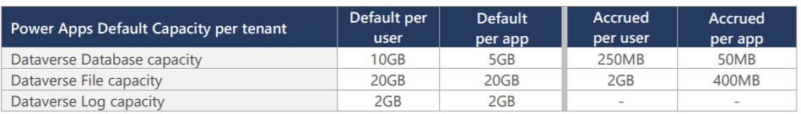
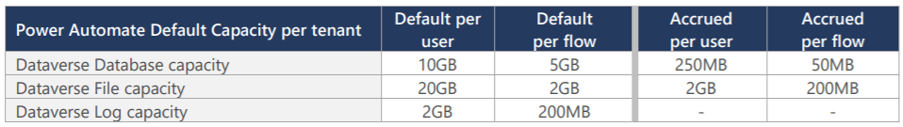
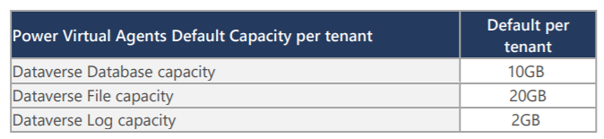
Understand Environment & Dataverse capacity
All environments with or without Dataverse will consume at least 1GB capacity.
Power Platform Admin Center contains a page for viewing and managing Power Platform capacity.
Available storage capacity is a condition for creating additional environments or increasing Dataverse data storage capacity.
Possibility to also buy additional Dataverse storage capacity in 1GB increments
Database Capacity
Store and manage entity definitions and data
File Capacity
Manage attachments, files, photos and videos
Log capacity
Record data changes over time for analysis & reporting purposes
Microsoft Confidential

Slide 20
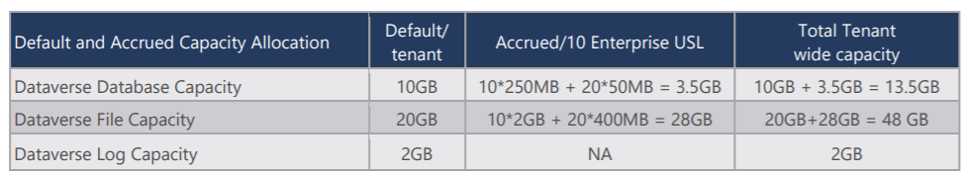
Example of tenant capacity
The first subscription of Power Apps (10GB) OR Power Automate (10GB) OR Power Virtual Agents (10GB) OR Dynamics 365 Customer Engagement provides the one-time default capacity entitlement for the tenant.
Additional subscriptions do not add to the tenant’s default capacity.
When additional subscriptions are added to the tenant, additional Dataverse capacity may accrue to the tenant.
Example:
Let’s assumed that a new customer starts by purchasing 10 Power Apps per user licenses and 20 Power Apps per app licenses. In this case, the total tenant wide pooled capacity will be as follows:
Microsoft Confidential

Slide 21
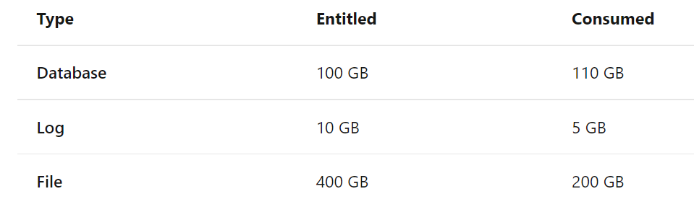
Capacity enforcement
Example 1 - Overage
Database storage is over capacity, overage enforcement
This tenant is 10 GB over in database usage. Despite having 200 GB excess file storage, the tenant is considered to be in deficit.
This tenant should free up storage or purchase more capacity.
Microsoft Confidential

Slide 22
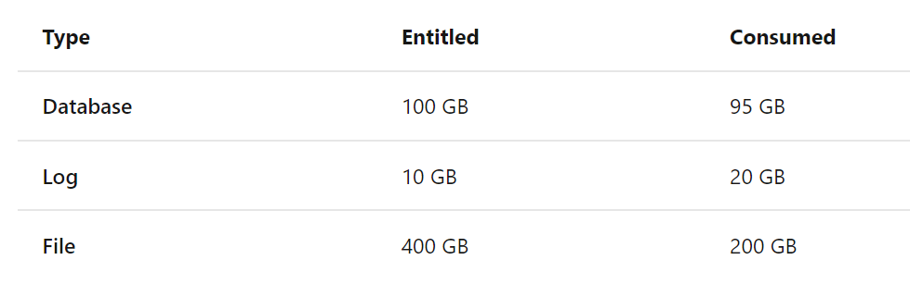
Capacity enforcement
Example 2 - Overage
Log storage is over capacity, overage enforcement
This tenant is 10 GB over in log usage and has only 5 GB available in database capacity; the tenant is considered to be in deficit.
This tenant should free up storage or purchase more capacity.
Microsoft Confidential

Slide 23
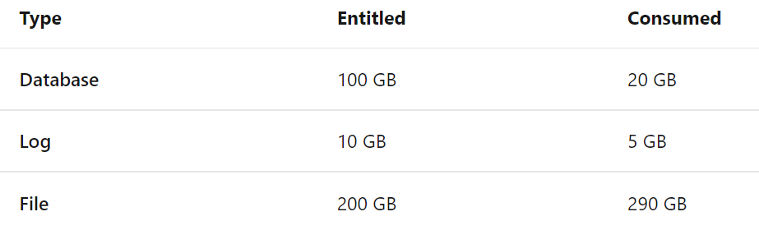
Capacity enforcement
Example 3 - Overage
File storage is over capacity, overage enforcement
This tenant is 90 GB over in file usage. Despite having 85 GB available (80 GB database + 5 GB log) in storage capacity; the tenant is considered to be in deficit.
This tenant should free up storage or purchase more capacity.
Microsoft Confidential

Slide 24
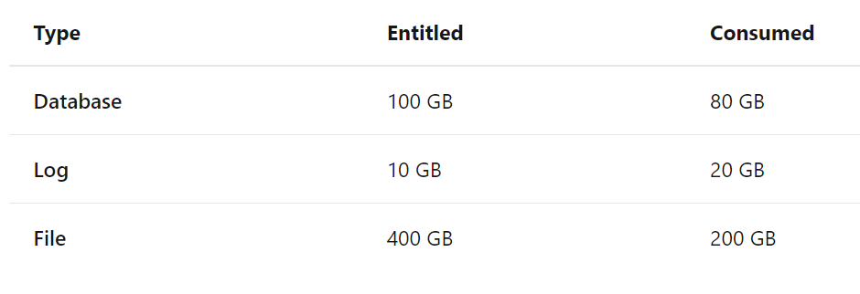
Capacity enforcement
Example 4 - No Overage
Log storage is over capacity
This tenant is 10 GB over in log usage but has 20 GB available in database capacity. Therefore, the tenant isn't in deficit.
Note that file storage excess entitlement can't be used to compensate deficits in log or database storage.
Microsoft Confidential

Slide 25
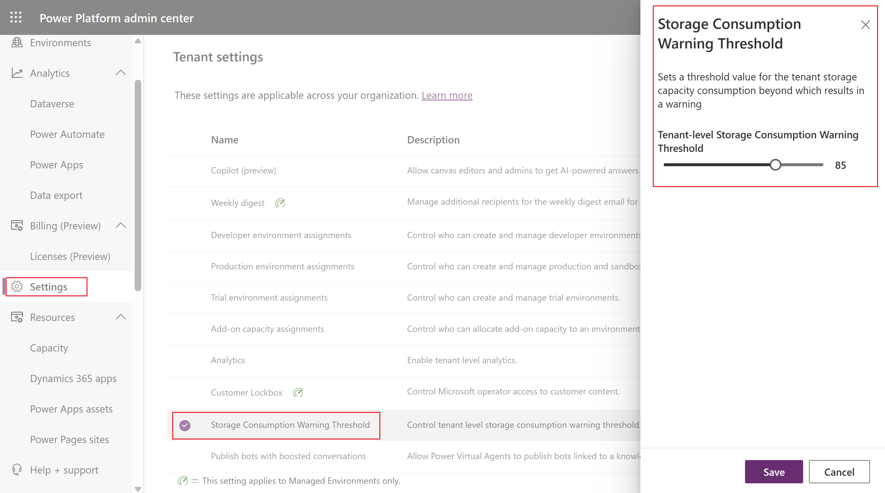
Storage Consumption Warning Threshold setting
Sets a threshold value for the tenant storage capacity consumption beyond which results in a warning.
Microsoft Confidential

Slide 26
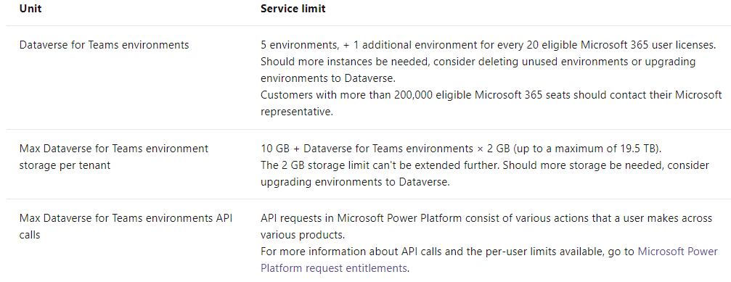
Dataverse for Teams Capacity Limits
The consumption won't count towards the tenant's capacity limits.
We'll provide a pool of capacity for Dataverse for Teams environments, which will be separate from the tenant’s Dataverse capacity pool.
Each Dataverse for Teams environment provides 2 GB of combined database and file storage, with a portion of this amount reserved for system use (about 512MB).
Microsoft Confidential

Slide 27
Dataverse for Teams capacity
Environment Enforcement
At 80% of the limit, the Microsoft Teams users will see in the Microsoft Teams maker experience a message informing them the capacity limit is about to be reached. At this point, customers are encouraged to either reduce storage usage or contact their admin for other options.
At 100% of the limit, any existing apps, chatbots, and flows will continue to work, and existing apps can be updated. However, new apps, bots, flows, and tables can't be created or installed as a result of having reached the capacity limit.
Microsoft Confidential

Slide 28
Dataverse for Teams capacity
Tenant Enforcement
At 80% of the limit, a notification that capacity is reaching its limit will be sent to the tenant admins (Global, Dynamics & Power Platform). The admin will be encouraged to consider reducing storage usage or upgrading some of the Dataverse for Teams environments.
At 100% of the limit, the creation of new Dataverse for Teams environments will be blocked. Any users attempting to create a new Dataverse for Teams environment will be prompted to contact the tenant admin as the result of the capacity limit being reached. Additionally, new apps, chatbots, flows, and tables won't be allowed to be created or installed in any existing Dataverse for Teams environment.
Microsoft Confidential

Slide 29

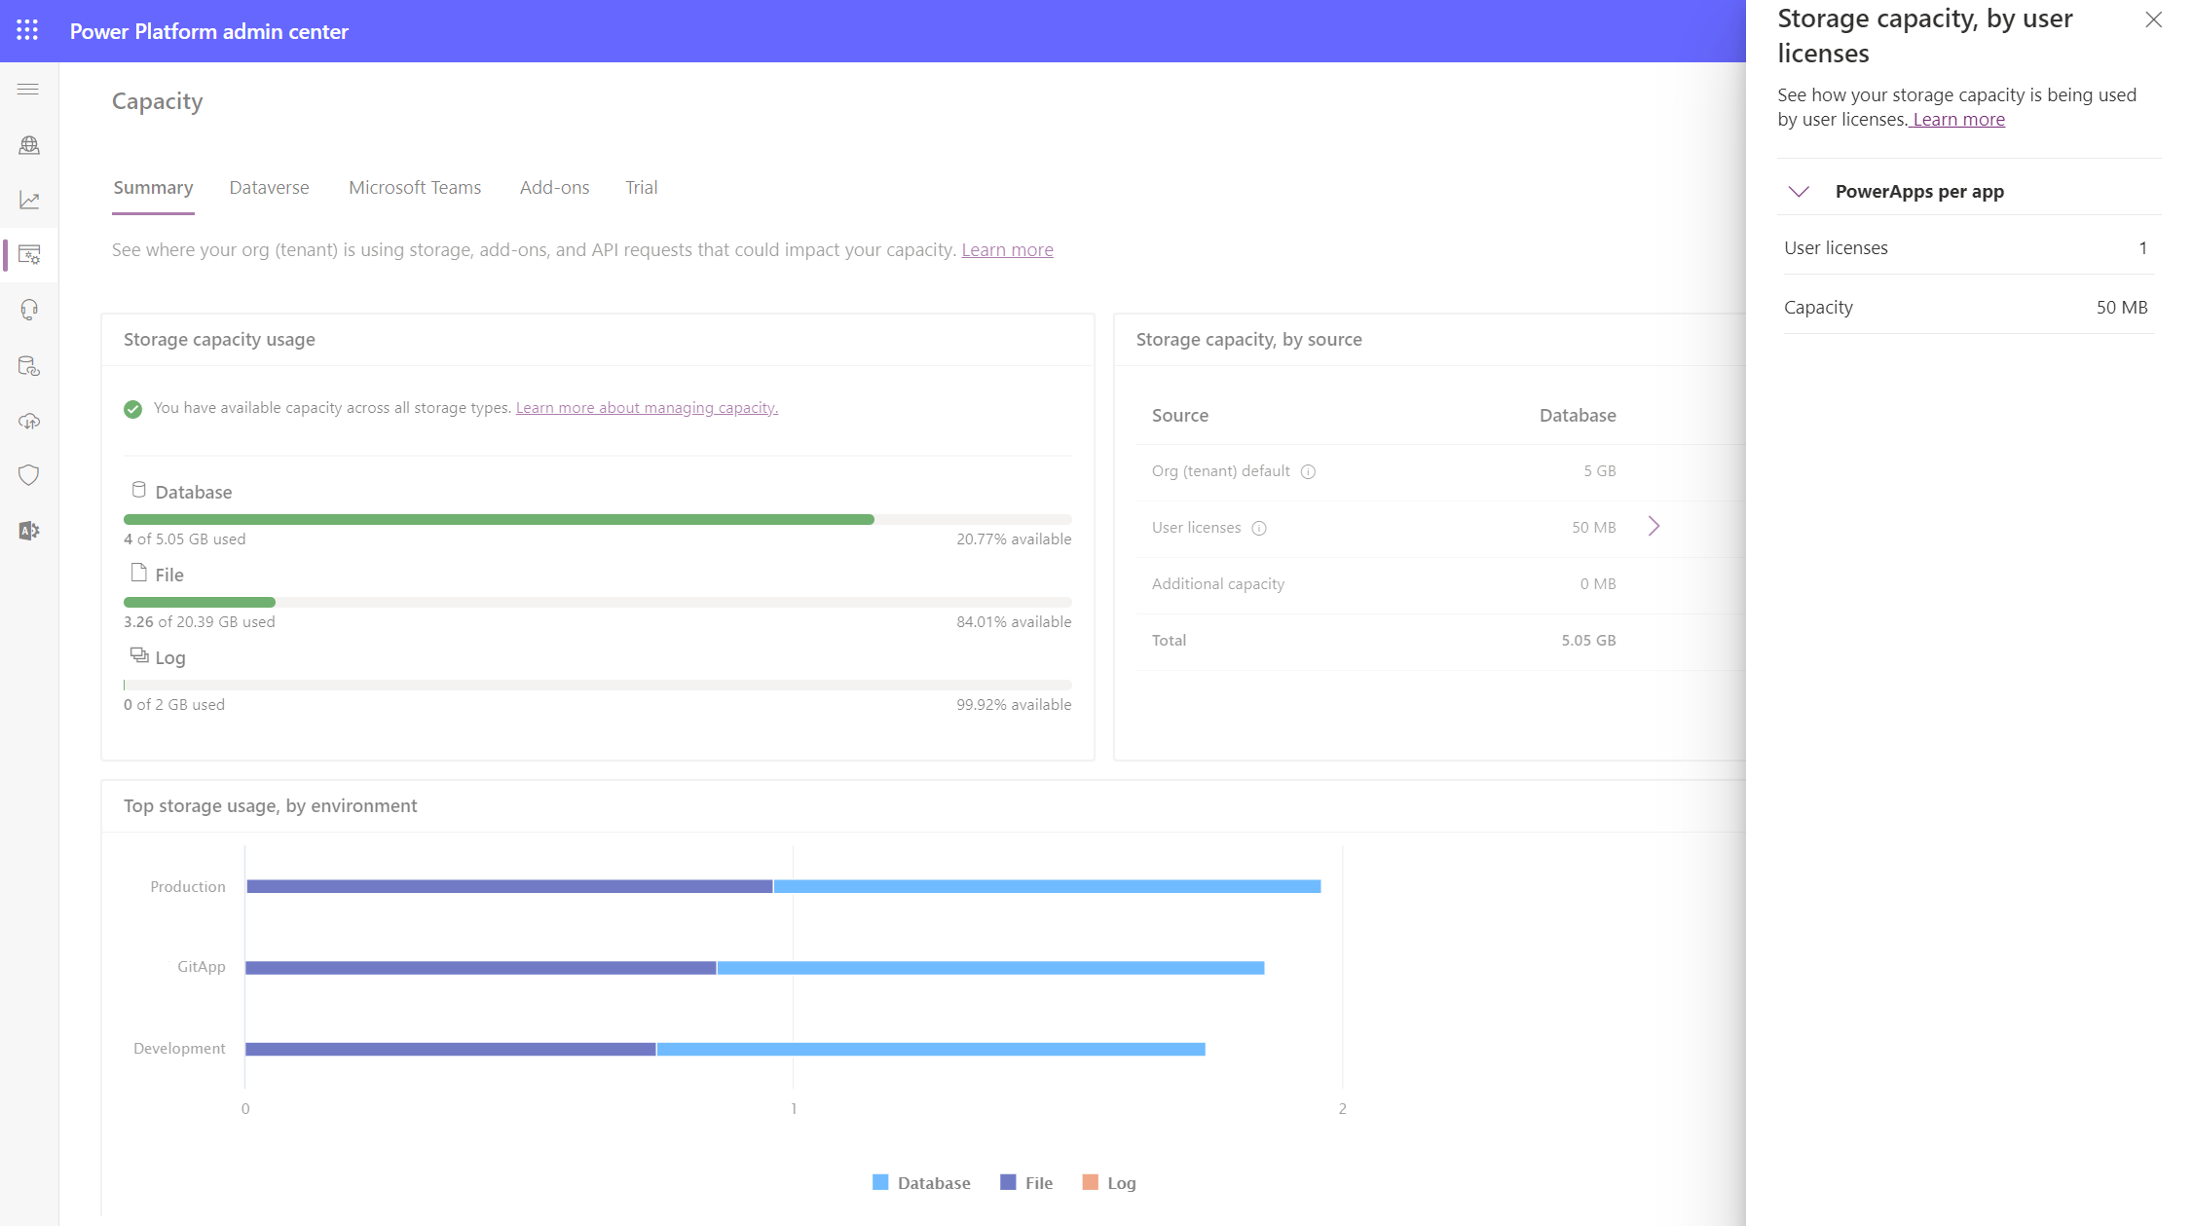
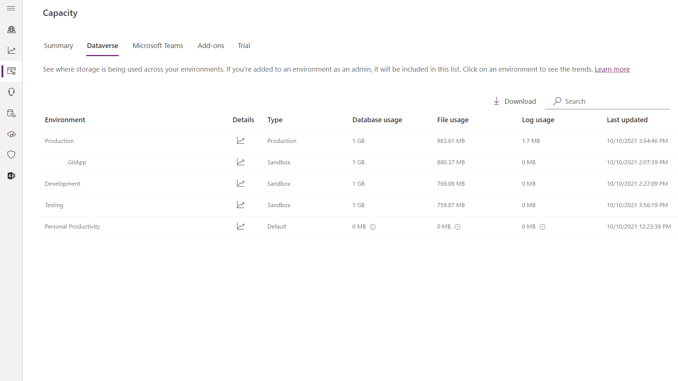
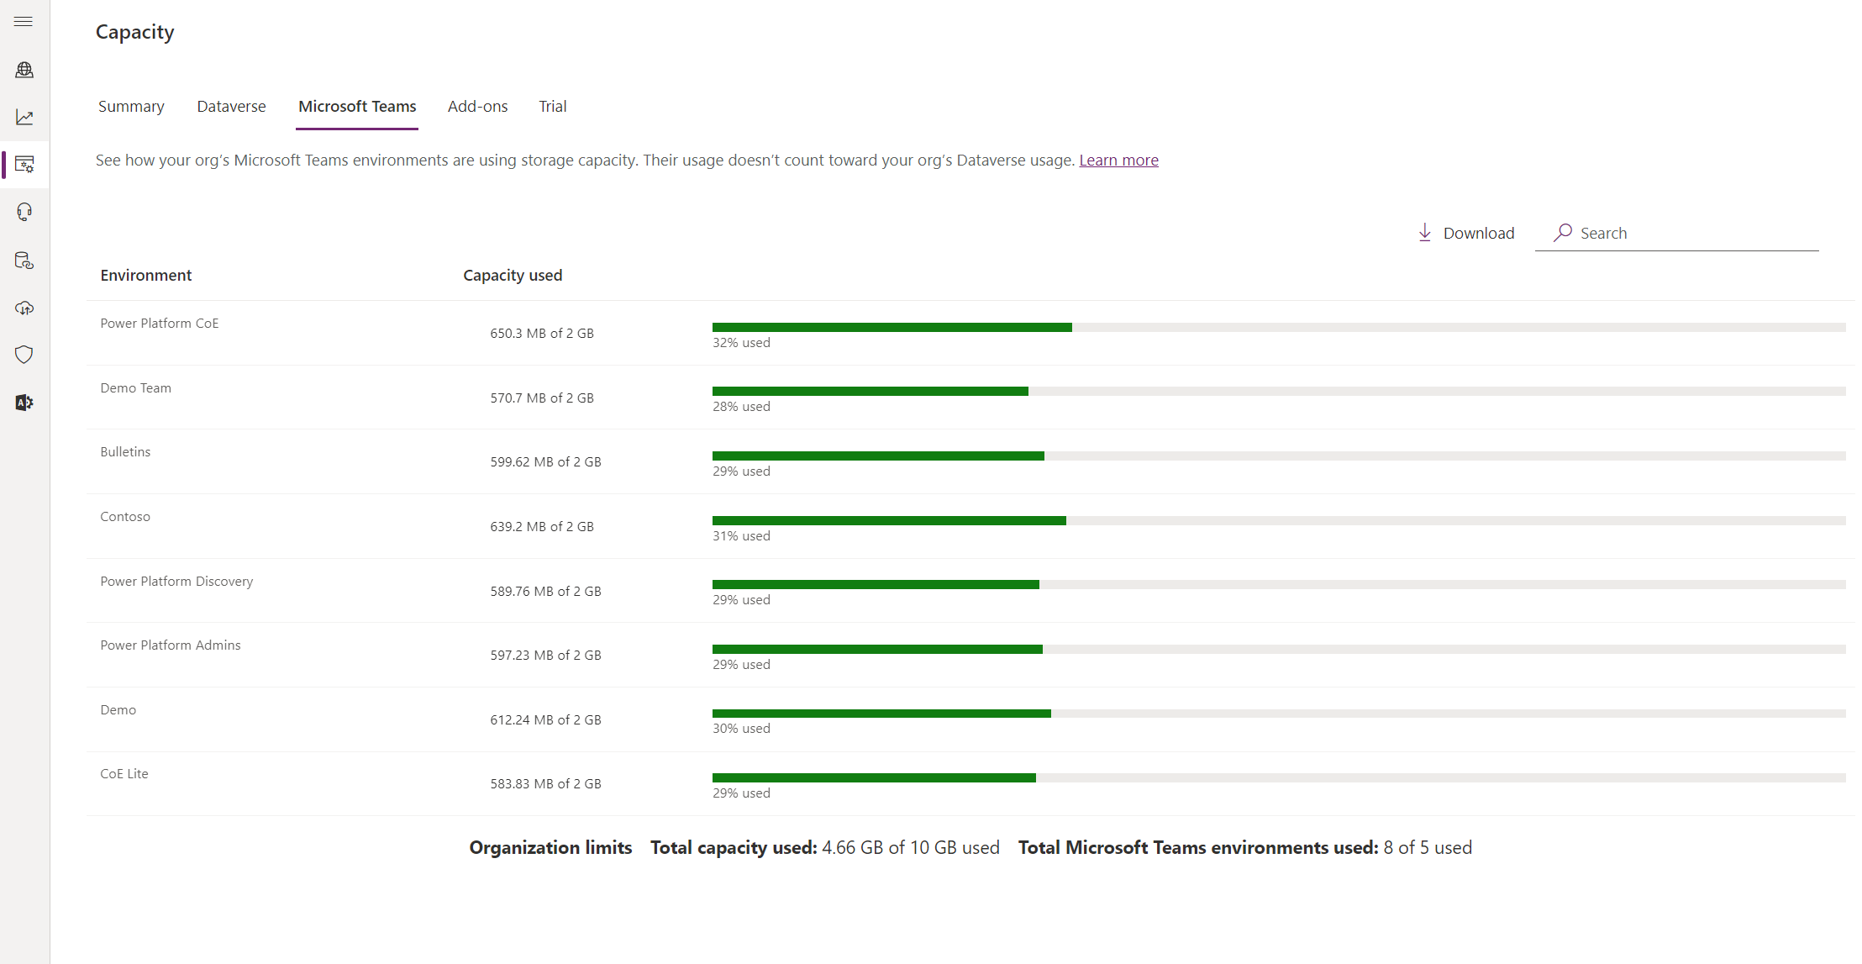
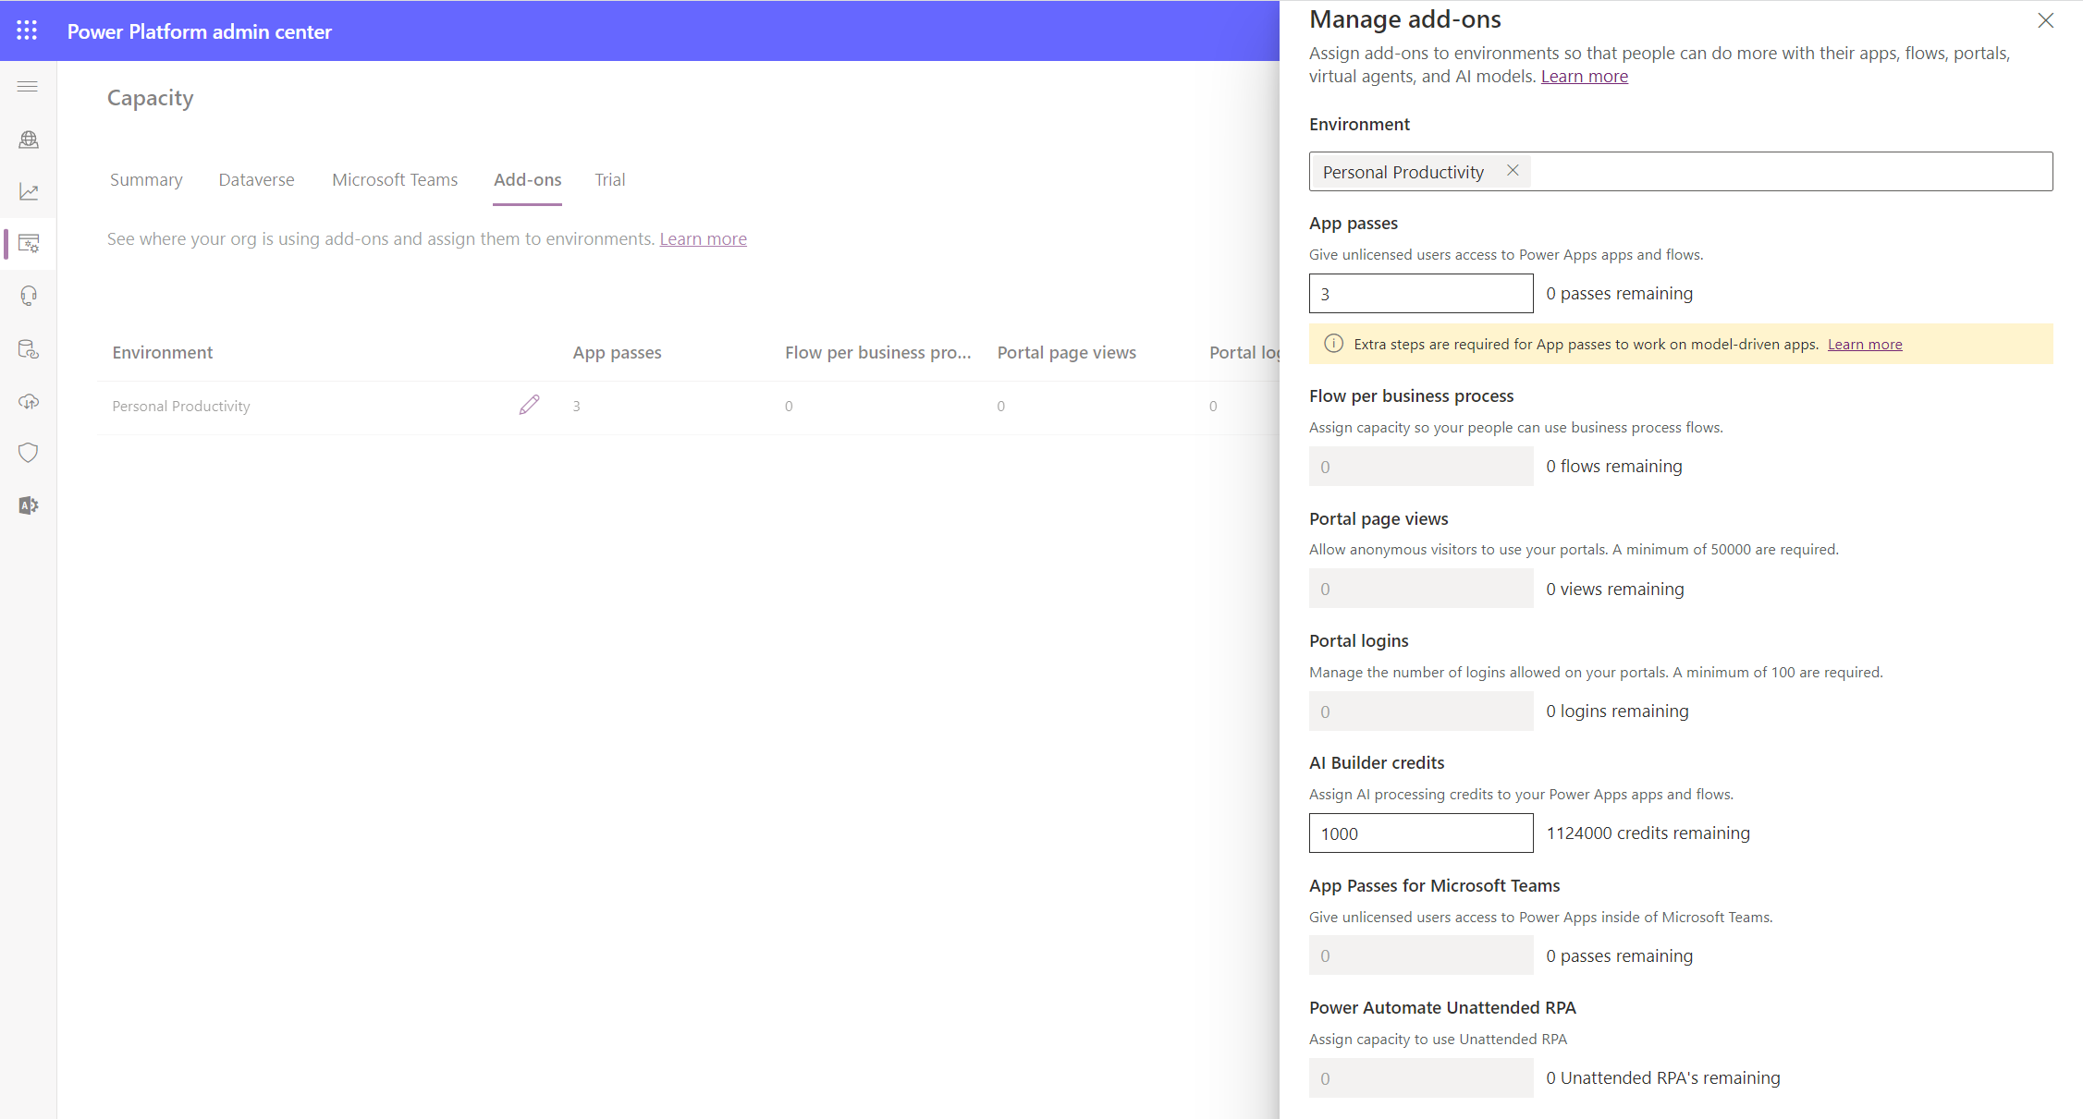
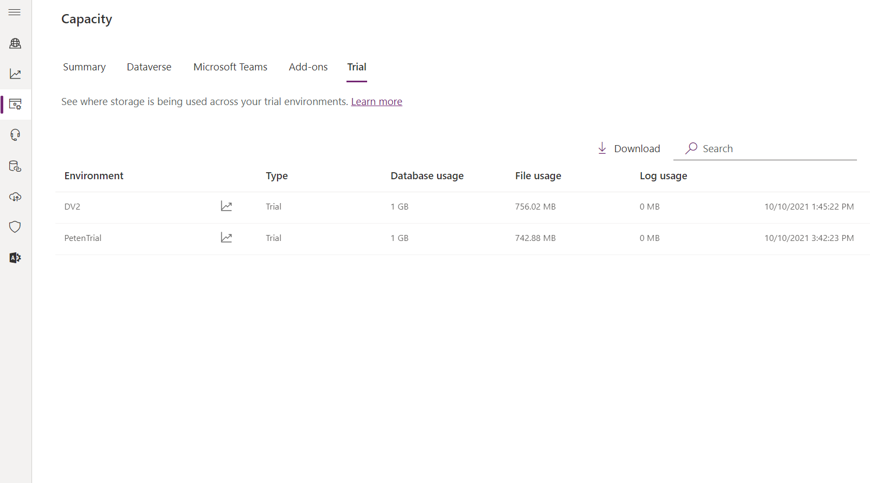
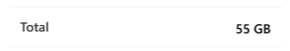
Tenant and environment level capacity reports
More about capacity analytics in Monitoring & Analytics module
25 GB
Capacity Summary
Dataverse Capacity per Environment
Dataverse for Teams environments capacity
Capacity add-on assignments
per environment
Trial environments capacity
Microsoft Confidential

Slide 30
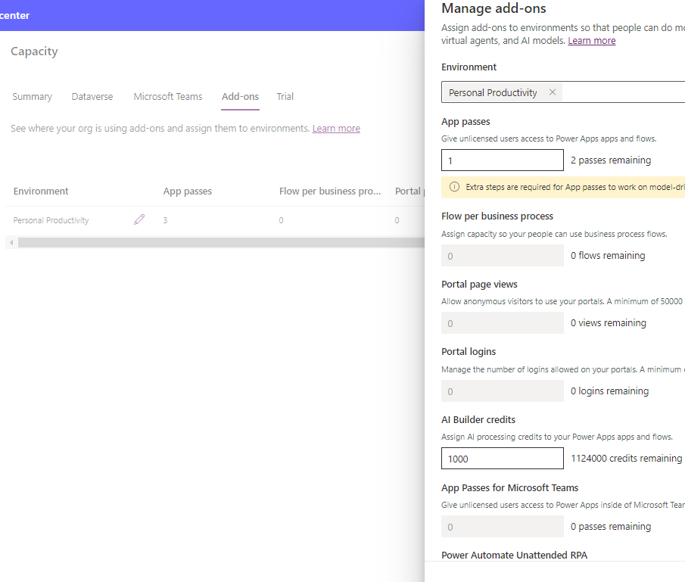
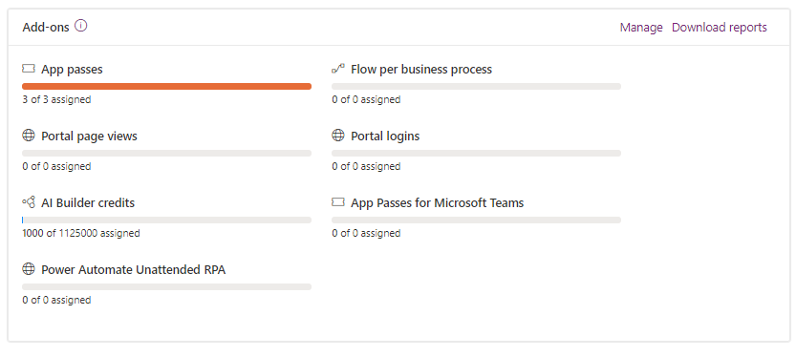
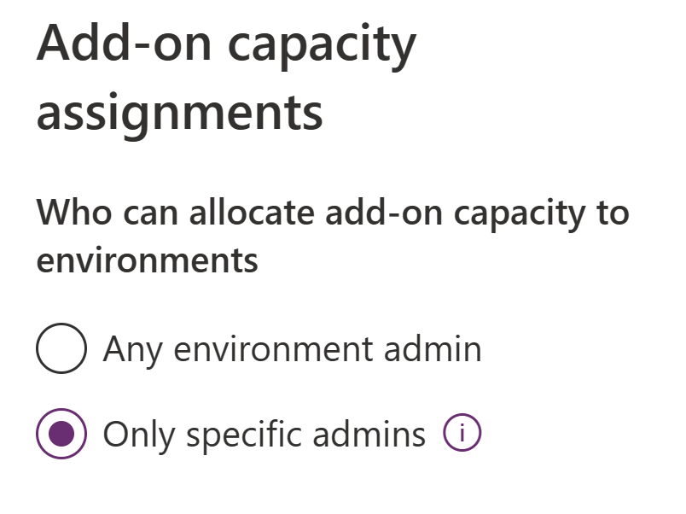
Add-on Capacity Management
If your organization has purchased capacity Add-ons, you must allocate that capacity to any environment where you want to use it.
Organization Add-on capacity summary information is visible in PPAC > Capacity > Summary page.
You can assign Add-Ons to environments in PPAC > Capacity > Add-ons where you also see environment level assignments.
You can also control who can allocate add-on capacity to an environment in PPAC > Settings > Add-On capacity Assignments.
Microsoft Confidential

Slide 31
Environment Security

Slide 32
Tenant level service admin roles
Global Admin
Full administration to all services in tenant
Power Platform Admin
Dynamics 365 Admin
Power Platform Admin role
Delegated Admin
Full administration to all services in tenant
Used for partners to provide support to customers
Full support for Power Platform
Microsoft Confidential

Slide 33
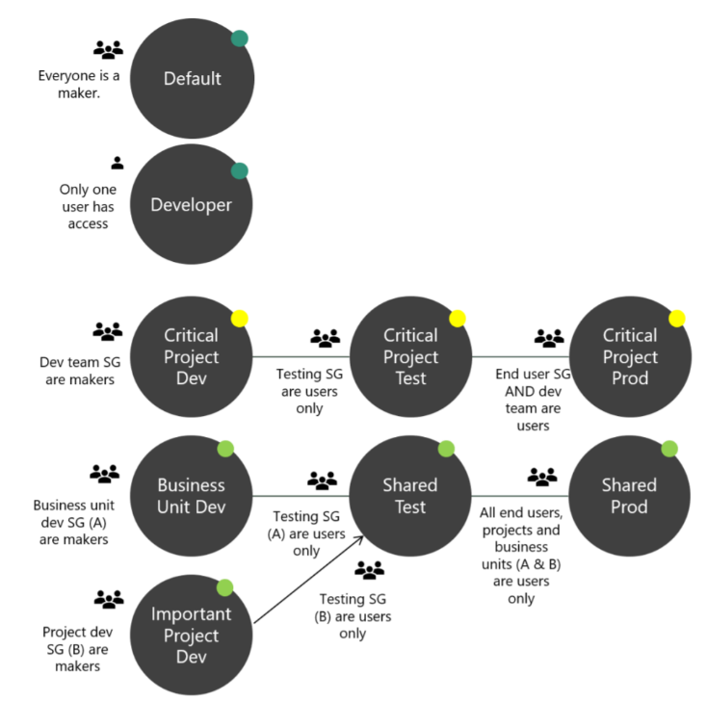
Strategy for establishing secure environments
Security checklist (learn more here):
Assign your admins the Power Platform service admin role.
Restrict the creation of net-new trial and production environments to admins.
Treat the default environment as a ‘Personal productivity’ environment.
Establish a process for requesting access to or creation of environments.
Dev/Test/Production environments for specific business groups/ applications.
Individual-use environments for POCs and trainings.
Establish Tenant and Environment level Data Loss Prevention (DLP) policies (discussed in more detail in DLP module)
Visual representation of an environment strategy at work.
Microsoft Confidential

Slide 34
Looking inside environments
Azure AD
Tenant
PowerApps
Default
Environment
PowerApps
Environment
Model Driven PowerApps
Table
SharePoint
PowerApps
PowerApps
Data
verse
Process Flows
Teams
Flows
Flows
Exchange
Business Rules
Excel
Security Model
Microsoft Azure
Azure AD
Data Gateway(s)
Logic Apps
Functions
Management API
Storage
On Premise Systems
On Premise Gateway(s)
Databases
Web API
SharePoint Data
File Storage
Microsoft Confidential

Slide 35
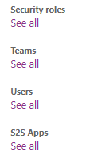

Environment security and access control
Environment Admin can perform all administrative actions like
View/manage resources
Add/remove a user or group from roles
Create DLP policies
Provision Dataverse database to envs
Environment Maker can create resources within an environment and distribute apps and flows they build using share functionality.
Environment
without Dataverse
Environment Roles
(Maker/Admin)
App
Flow
Resource Permissions
(Owner/Contributor/User…)
Custom Connector
Once a Dataverse database has been created, the Dataverse security roles take over for controlling security.
Environment with Dataverse
Environment Roles
(Maker/Admin)
App
Resource Permissions
(Owner/Contributor/User…)
Access to resources are controlled using
Dataverse security roles
Resource permissions for apps/flows/custom connectors/etc.
Learn more about Dataverse security roles from here
Flow
Custom Connector
Environment & Dataverse Roles
(Maker / System Admin Customizer…)
Dataverse
Microsoft Confidential

Slide 36
Key out-ot-the-box security roles you need to know
Environment Admin /
System Administrator
System Customizer
Environment Maker
Basic User
Microsoft Confidential
Notes:
Environment Admin/System Administrator
Complete ability to customize and administer the environment
Full read-write access to data in the database
The role cannot be modified
Care should be taken in assigning these permissions to the right people
System Customizer
Full permission to customize the environment
Data access is focused only on data owned by the user
Role can be modified but it is not recommended to modify
Environment Maker
Create new resources in the environment including apps, connections, gateways and flows
There are no default privileges to data included
Role can be modified but it is not recommended to modify
Basic User
Basic user role, with ability to run apps and perform common tasks but no ability to customize the system
The data access is focused on Read access to most Common Data Model core entities with full access to records owned by the user (that is, ‘self’ privileges)
Good role to copy to make a custom security role for users

Slide 37
Security with Dataverse in an environment
Each security role grants discrete privileges.
Users are associated with an environment either directly or the-just in-time via an Azure AD Group.
Access to apps, data, and services are by association with one or more security roles.
Data can be secured down to the field level.
Microsoft Confidential
Notes:
There should also be a good strategy in place for securing the Dataverse environment also. The Power Platform makes this simple to do with the Azure AD and the ability to assign distinct roles. It is important to assign appropriate security roles for environment users since their role dictates their privileges in the environment.

Slide 38
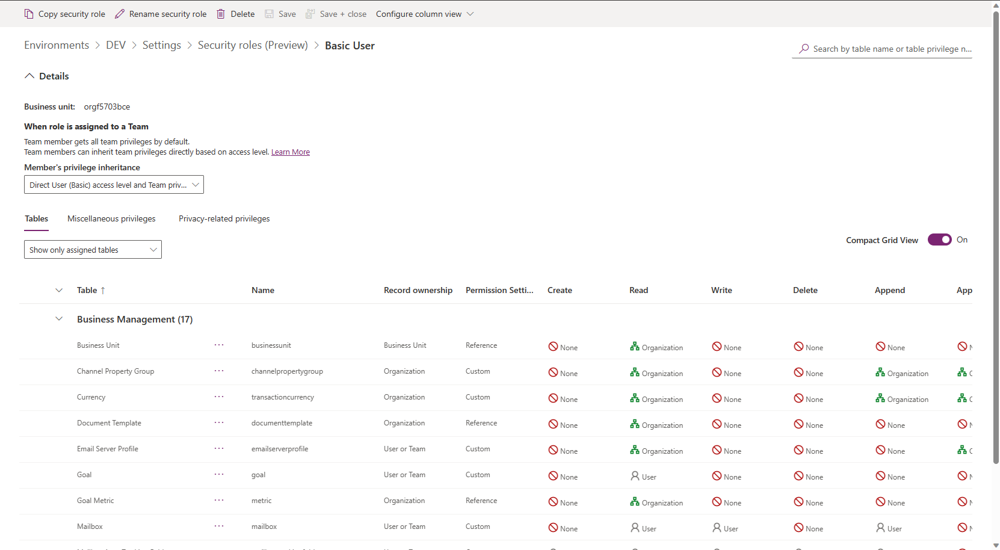
Customizing Security Roles
If your app uses a custom table, its privileges must be explicitly granted in a security role before your app can be used. You can either add these privileges in an existing security role or create a custom security role.
Microsoft Confidential
Notes:
There should also be a good strategy in place for securing the Dataverse environment also. The Power Platform makes this simple to do with the Azure AD and the ability to assign distinct roles. It is important to assign appropriate security roles for environment users since their role dictates their privileges in the environment.

Slide 39
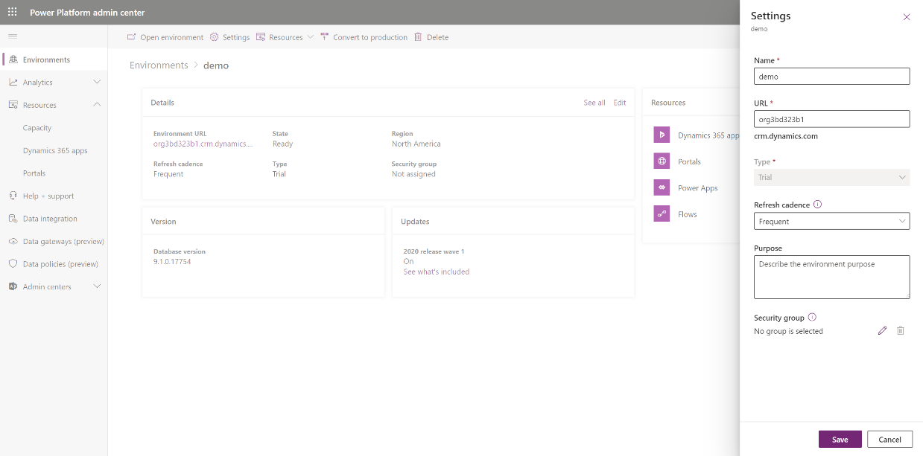
Controlling User Access to Dataverse environments
If your company has multiple Dataverse environments, you can use Azure AD security and Microsoft 365 groups to control which licensed users can be a member of an environment.
If you do not specify a security group, all users who have a Dataverse license, will be added to the environment (but no security roles will be added).
When a security group is associated with an existing environment with users, all users in the environment that are not members of the group will be disabled.
Microsoft Confidential
Notes:
There should also be a good strategy in place for securing the Dataverse environment also. The Power Platform makes this simple to do with the Azure AD and the ability to assign distinct roles. It is important to assign appropriate security roles for environment users since their role dictates their privileges in the environment.

Slide 40
Dataverse for Teams environment user access
Every team in Teams is linked 1:1 to a Microsoft 365 group.
Two user membership types: owners and members.
Members can be users from the customer's own tenant or from a guest tenant.
Any user management (addition, removal, user type change) made in a team will be reflected in the Microsoft 365 group and vice versa.
Access to a Dataverse for Teams environment and its resources (apps, data) will be restricted to users in the Team. However, it is now possible to share an app in Dataverse for Teams with users outside of the team – Click here for more info.
The Microsoft 365 Group linked to a team will be automatically associated with the Dataverse for Teams environment, restricting access to users of that Microsoft 365 group.
This Microsoft 365 Groups association with the Dataverse for Teams environment won't be editable until the environment is promoted to Dataverse.
Microsoft Confidential
Notes:
There should also be a good strategy in place for securing the Dataverse environment also. The Power Platform makes this simple to do with the Azure AD and the ability to assign distinct roles. It is important to assign appropriate security roles for environment users since their role dictates their privileges in the environment.

Slide 41
Dataverse for Teams role assignments
Persona | Security role auto-assigned | Description
Teams owner | System Administrator | Manage Team’s membership and settings Full access to the environment's apps, resources, and data. Perform environment maintenance tasks in PPAC
Teams member | Teams Member | View env's resources, run all apps and resources, and create or update their own resources. Full data access
Teams guest | Teams Guest | Can view and run all resources in the team By default, guests have full access to records they create and don't have access to other users' records.
GA / PP Admins | System Administrator | Can perform environment maintenance tasks such as backup and restore in all DVfT environments They need not be owners or members of the team, but through their tenant-level admin privileges they System Administrator privileges with R/W access mode to Dataverse for Teams environments.
Dynamics 365 admin | System Administrator* | These admins need to be owners or members of the team to have System Administrator–level privileges to manage the health and maintenance of the environment.
Colleagues with access | Basic User | Users of the same tenant who aren't in the team but have been invited to run apps in the team By default, no access to data but can be granted based on the app or resources that they need to run (will automatically remove M365 Group association from Dataverse for Teams environment)
*System Administrator if owner in the team; System Administrator and Teams Member if they are a member in the team.
No access if they aren't an owner or member in the team.
Microsoft Confidential
Notes:
There should also be a good strategy in place for securing the Dataverse environment also. The Power Platform makes this simple to do with the Azure AD and the ability to assign distinct roles. It is important to assign appropriate security roles for environment users since their role dictates their privileges in the environment.

Slide 42
Managing Environments

Slide 43
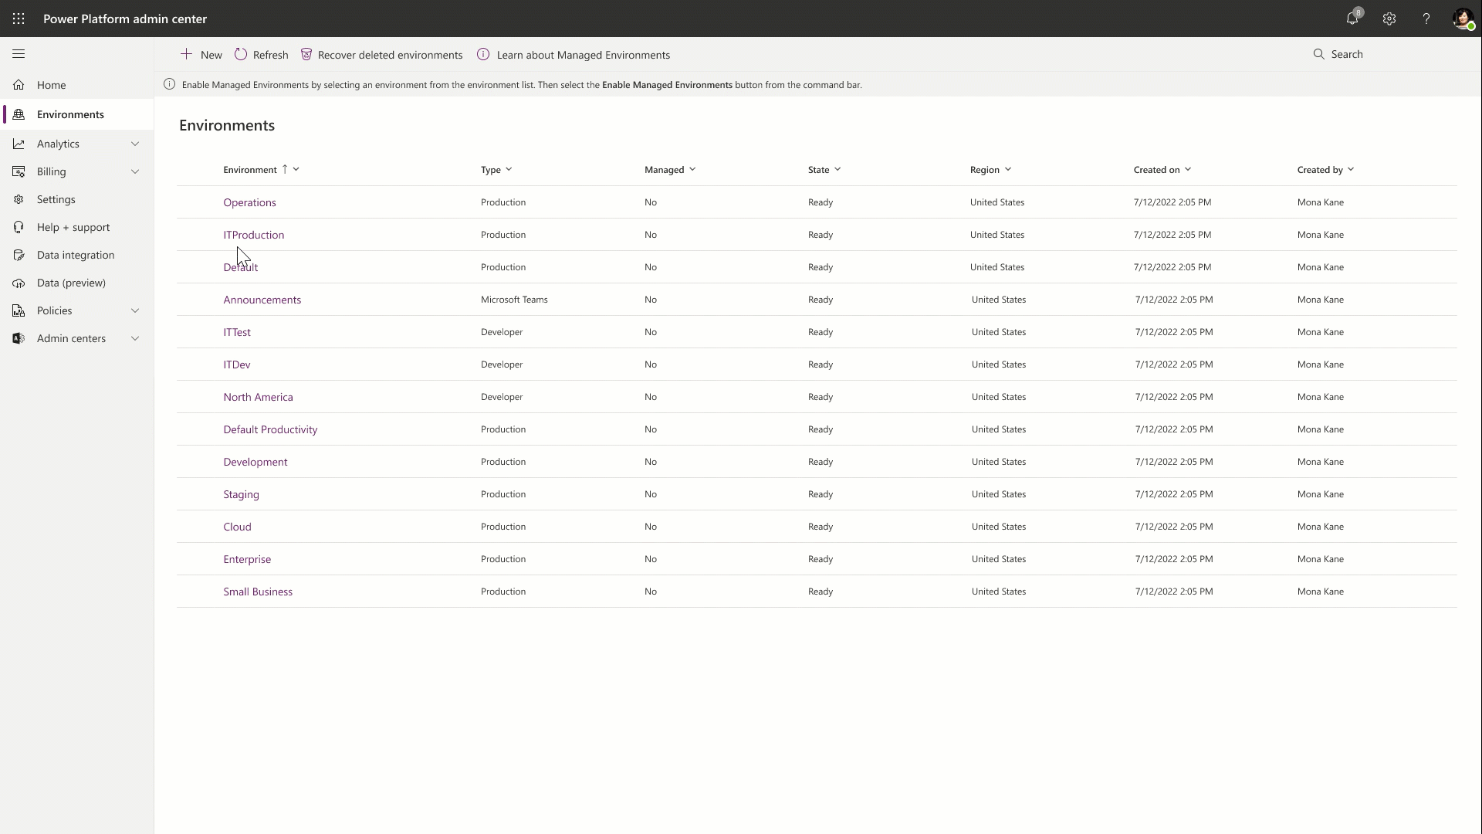
Managed Environments
Managed Environments offer a set of enhanced out-of-the-box governance capabilities that simplify, automate, and streamline IT administration of Microsoft Power Platform at scale.
Primary elements of Managed Environments:
Limit sharing
Weekly digests
Data policies
Set up Power Platform pipelines
Requires apps/flows/users to have a standalone premium license.
Microsoft Confidential
Notes:
More to come with managed environments:
Enable Maker welcome content
Use Solution checker

Slide 44
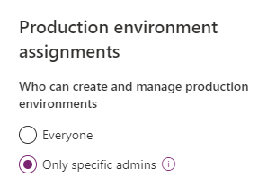
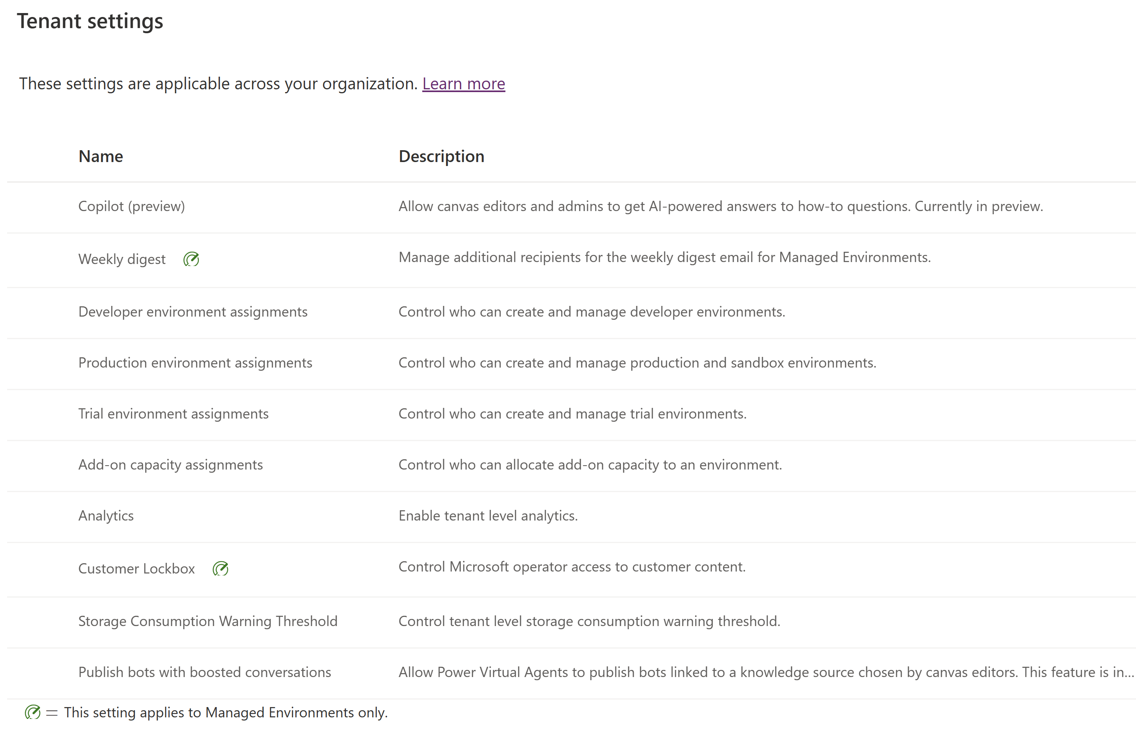
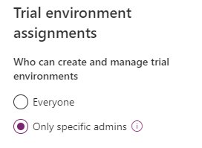
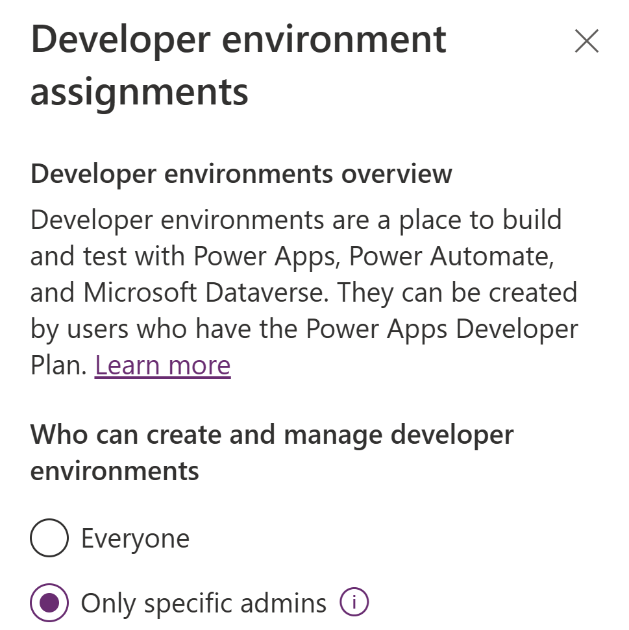
Tenant Settings
Control who can create environments and manage other settings
In Power Platform Admin Center, Click Settings in the left menu. You can also click the gear icon on the top right corner and click Power Platform Settings.
Microsoft Confidential
Notes:
We recommend setting all of these to Only specific admins.

Slide 45
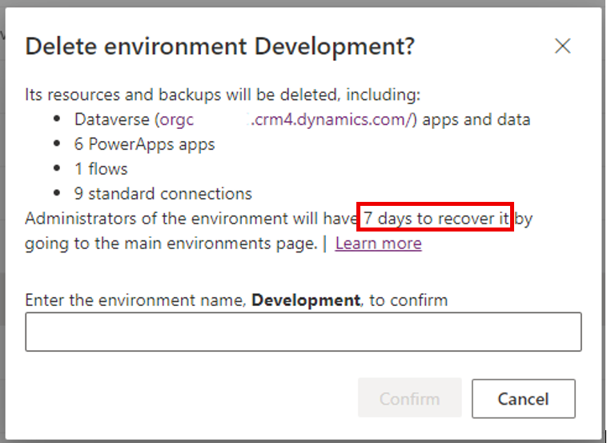
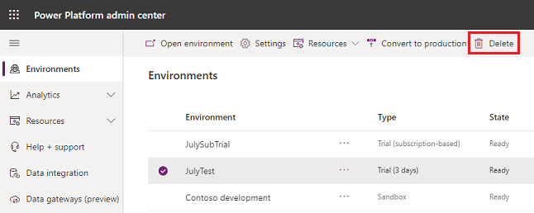
Delete Environment
You can delete an environment to recover storage space and to remove Personally Identifiable Information (PII)
In Power Platform Admin Center open environments list, select an environment and click Delete.
NOTE: You can't delete the default environment.
Microsoft Confidential

Slide 46
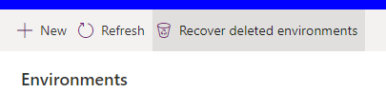
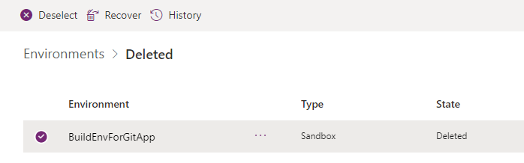
Recover Environment
You can recover a deleted environment within 7 days of deletion in PPAC or using PowerShell Recover-AdminPowerAppEnvironment.
Available storage capacity might be required in order to successfully recover an environment depending on the type of environment being recovered.
Microsoft Confidential

Slide 47
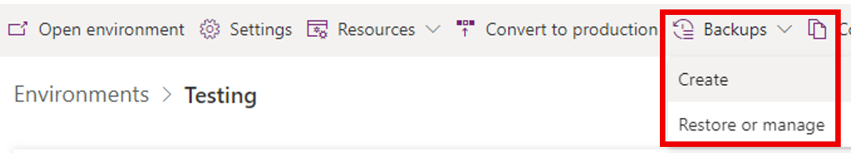
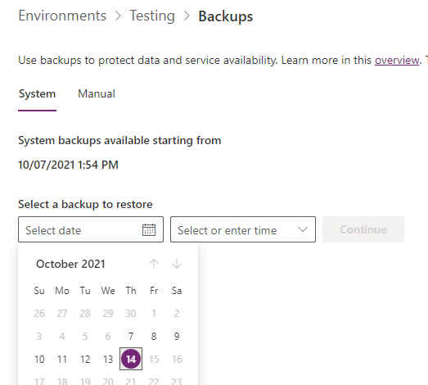
Backup and Restore Environments
System backups:
All your environments except Trial environments are backed up
System backups occur continuously
The underlying technology used is Azure SQL Database
Production backups with database are retained 7 days or if at least one D365 application installed then 28 days
Sandbox backups are retained for 7 days
You must restore an environment to the same region in which it was backed up.
When an environment is restored onto itself, audit logs are not deleted.
Manual backups:
You can manually backup Production and Sandbox environments.
You can't back up the default environment.
Production backups are retained 7 days or if at least one D365 application installed then 28 days.
Sandbox backups are retained for 7 days.
Microsoft Confidential

Slide 48

Dataverse for Teams environment lifecycle
Environment name is the same as the Team name.
Lifetime of the environment will be tied to the Team it was created in.
If you promote an environment to Dataverse (full version), the 1:1 mapping isn't guaranteed because the environment can now be used by applications outside of Teams.
The promoted environment is bound by the lifecycle rules associated with the Power Apps license and the configuration of the environment.
Power Platform provides a cleanup mechanism that automatically removes Dataverse for Teams environments from your tenant that are left inactive. An environment will first be disabled after 90 days of inactivity. If no action is taken by administrators and the environment is left disabled for 30 days, it will then be deleted. Administrators have 7 days to recover deleted environments – More info.
Microsoft Confidential
Notes:
There should also be a good strategy in place for securing the Dataverse environment also. The Power Platform makes this simple to do with the Azure AD and the ability to assign distinct roles. It is important to assign appropriate security roles for environment users since their role dictates their privileges in the environment.

Slide 49

Environment Administration Mode
Environment can be set to Administration mode which allows only users in System Administrators and System Customizers roles to login to environment.
Supported in Sandbox, Production, and Trial (subscription-based) environments
This is useful when you want to make operational changes and not have regular users affect your work and have your work affect end users (non-admins).
Possible to also disable all asynchronous Background operations, such as workflows and Exchange sync
Microsoft Confidential

Slide 50
Move Environment
You can use the Tenant-to-Tenant Migration feature to request to have an environment in one tenant moved to another tenant. To do so submit a support request.
Possibility to move one or multiple environments
You will need to create a temporary environment or environments in the destination tenant, depending on how many source environments you are migrating.
Source environment type and destination environment type must match.
After moving environments to another tenant:
The environment ID in the target tenant cannot be set to the same environment ID as in the source tenant. This is not supported.
The org URL, org ID, and the name do not change.
Security group mapping is handled as part of the manual tenant to tenant migration process. At the very least, a replacement (or removal) will be needed because the security group won’t exist with the same ID in the new Azure AD tenant.
Microsoft Confidential

Slide 51
Questions?

Slide 52
Lab Setup
Lab Description
NOTE! Labs are included only in 3-day version of the workshop
Follow the steps below to setup workshop lab environment:
Every workshop attendee will be having a dedicated demo tenant along with virtual machines environment to perform upcoming labs.
Use Edge Chromium or Chrome web browser to navigate to http://aka.ms/lod
Click on Sign in then select Microsoft Account
Sign-in using Microsoft personal account (other email service account can also work) – don’t use business email.
Select WorkshopPlus menu item then click on My Training
Click on Redeem training key (course instructor will share the key)
In loaded page, scroll to Lab section then select Workshop labs title link to launch it.
In virtual labs environment select Resources tab and the open ContosoGateway server.
In Resources tab, you can find also the Office 365 Credentials you need to sign into your own lab tenant.
Notes:
Link to lab: https://labondemand.com/LabProfile/
##########

Slide 53
LABS – Provision environments
Lab Description
Lab 1 - Provisioning Power Platform environment Lab 2 - Provisioning Dataverse for Teams environment
Notes:
Link to lab: https://labondemand.com/LabProfile/
##########

Slide 54
Microsoft

